Slide 1


Audiologic Evaluation of the Tympan Open Source Hearing Aid
Joshua M. Alexander, Ph.D., CCC-A
TinyURL.com/PurdueEAR

Slide 2
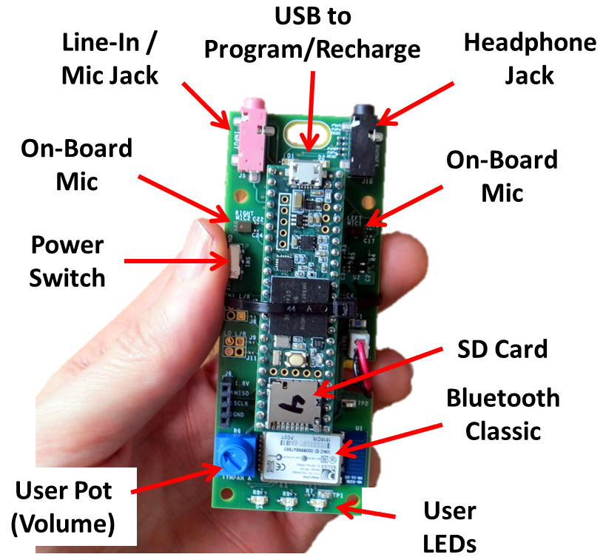
Tympan Hardware and Specs
Processor
NXP MK66F (ARM Cortex M4F Core)
180 MHz with Floating-Point Unit and DSP Extensions
Analog-Digital
Texas Instruments TLV320AIC3106, stereo ADC and DAC
32/24/20/16-bit configurable (93 dB SNR)
Low-noise, software-controllable gain on inputs
Software-controllable microphone bias
Software-controllable headphone amplifier
Data Interfaces
USB Serial, USB Audio, USB HID
Bluetooth Classic
SD Card
Digital microphone port
Power
Draws about 100 mA @ 3.7V
Power from USB or Li-Po Battery
On-board recharging from USB (with indicators)
Programming
Reprogram via USB; Program in C/C++
Free, open-source toolchain
User Interaction
Potentiometer, LEDs, Bluetooth

Slide 3
Metrics Evaluated
Throughput delay
Internal noise
Maximum output
Total harmonic distortion
Frequency response
Compression parameters
Input/output function: CT, CR
Attack/release times
Directionality
Audiometric fitting range
Probe microphone feasibility

Slide 4
ANSI S3.22, Annex C “Guidelines for additional optional tests to characterize hearing aids”
C.1 Characteristics of the gain control
C.2 Characterization of battery current as a function of quiescent current and maximum current
C.3 Effect of tone-control setting on frequency response
C.4 Effect of output limiting control setting on OSPL90 and full-on frequency response
C.5 Effect of gain control setting on frequency response
C.6 Effect of power supply voltage variation on acoustic gain and OSPL90
C.7 Effect of power supply impedance variation on acoustic gain and OSPL90
C.8 Hearing aid output noise spectrum
C.9 AGC hearing aids
C.10 Total harmonic distortion in acoustic mode as a function of input SPL
C.11 Total harmonic distortion in acoustic mode as a function of frequency
C.12 Maximum induction coil sensitivity measurement
C.13 Total harmonic distortion for induction coil mode as a function of input magnetic field strength
C.14 Difference frequency distortion

Slide 5

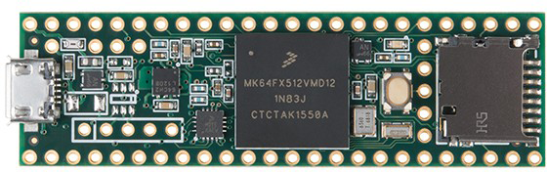
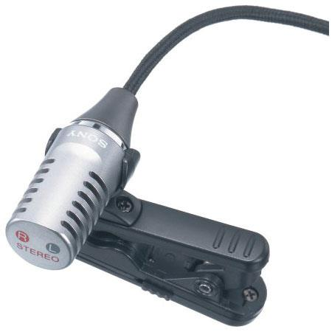
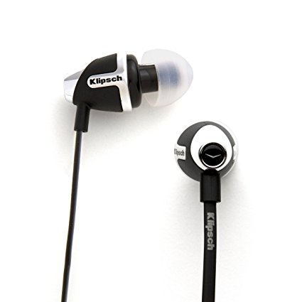
Hardware and Software
Arduino Software v1.8.3
Teensy 3.6 audio processing board
Sony ECM-CS10 Lapel Electret Microphone
Klipsch S4 earphones

Slide 6
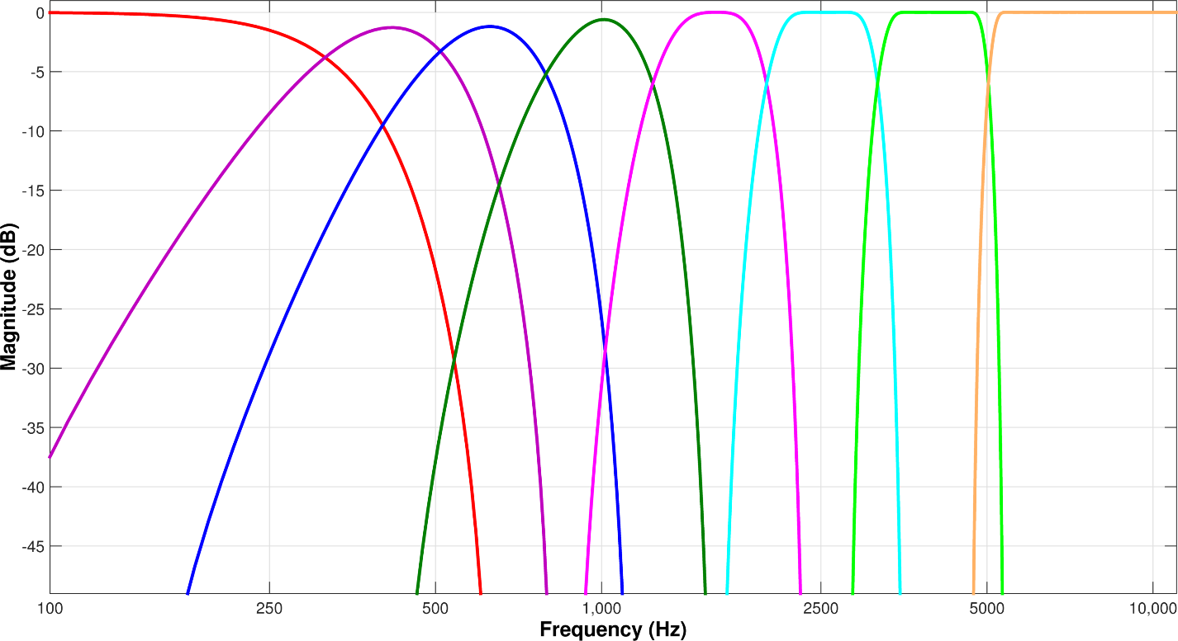
“Out of the Box” Setup
8-channel WDRC (Alexander papers), 20-30 dB gain
Stage | Kneepoints | Ratios | Attack | Release
Expansion | 32-45 dB SPL | 1 : 1.75 | 40 ms | 5 ms
Compression | 50 dB SPL | 1.5 : 1 | 5 ms | 40 ms
Output-limiting | 90/105 dB SPL | 10 : 1 | 5 ms | 40 ms

Slide 7
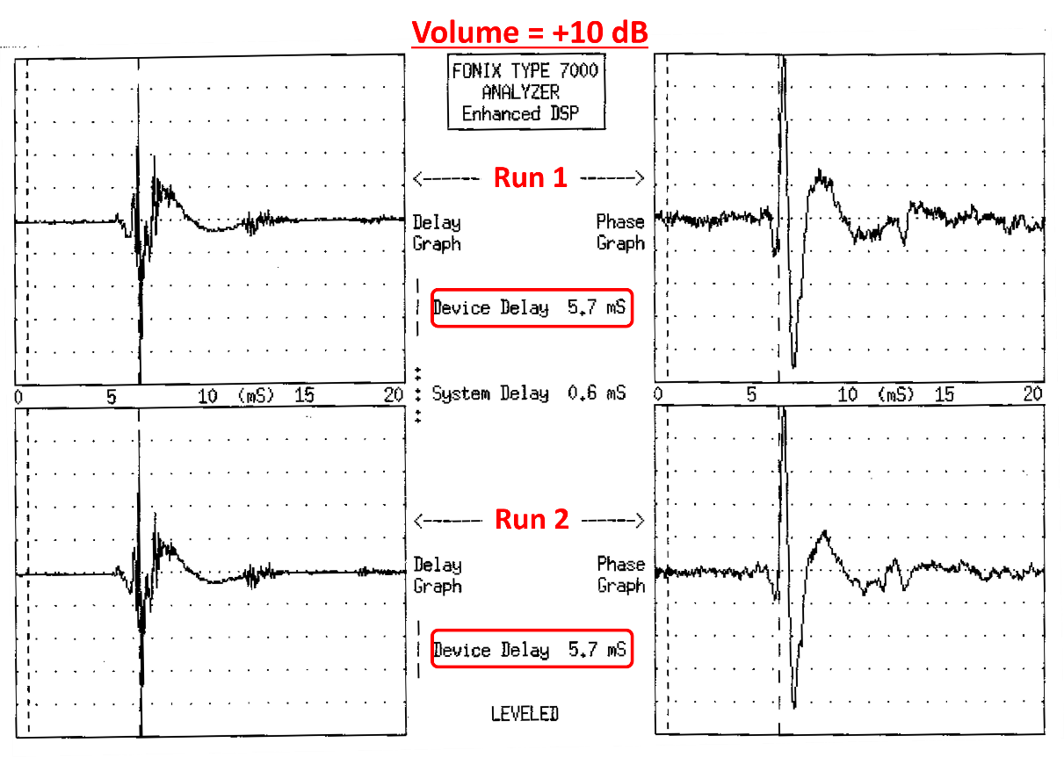
Throughput Delay
5.7 sec as measured using a Frye Fonix 7000 hearing aid analyzer
Alexander (2016)
http://www.canadianaudiologist.ca/issue/volume-3-issue-4/hearing-aid-delay-feature/

Slide 8
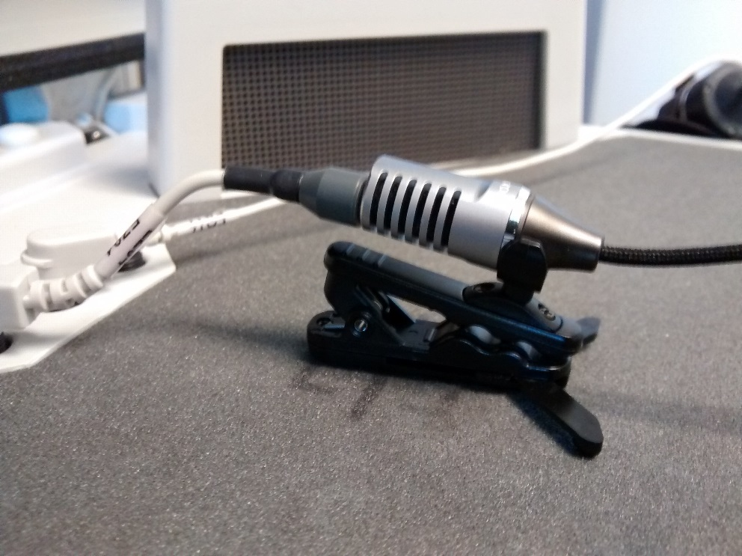
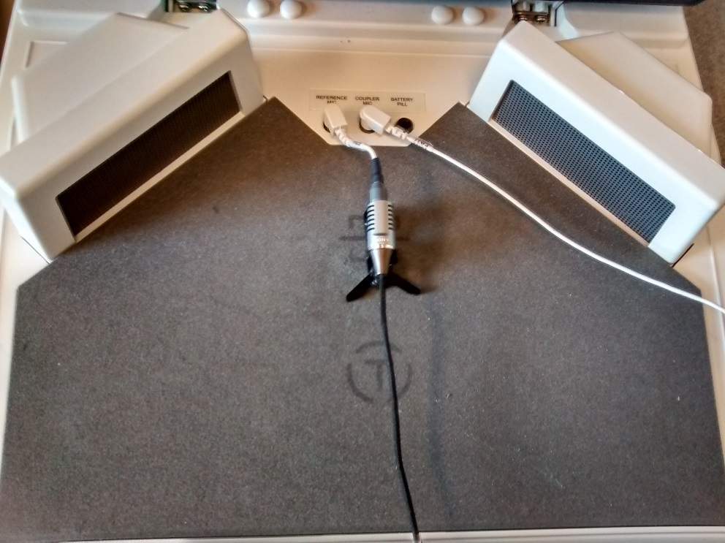
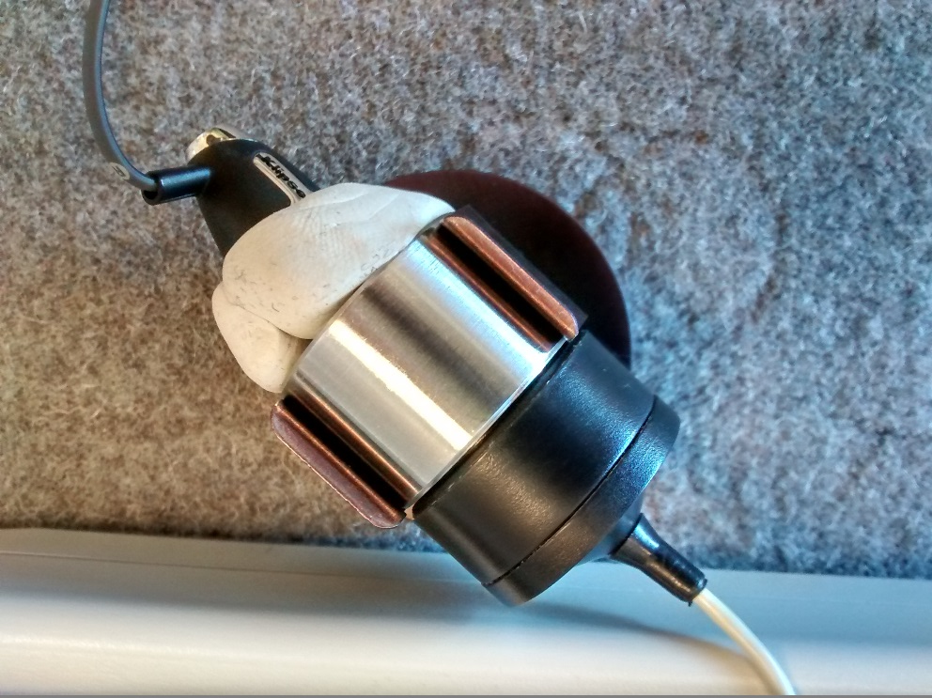
Hearing Aid Test Box Set Up
Audioscan Verifit 1
2 cc (HA-1 coupler)

Slide 9
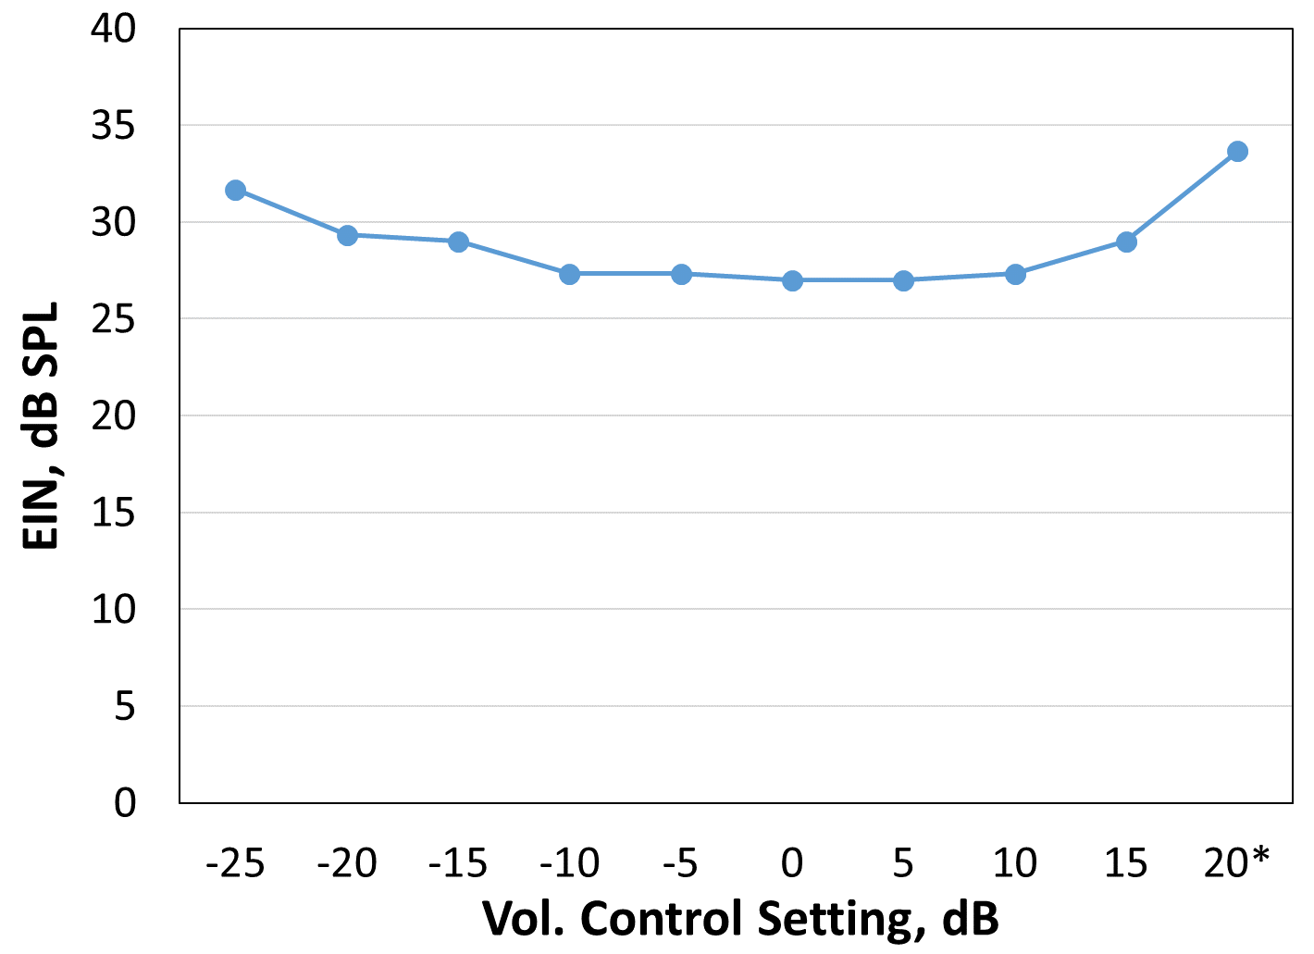
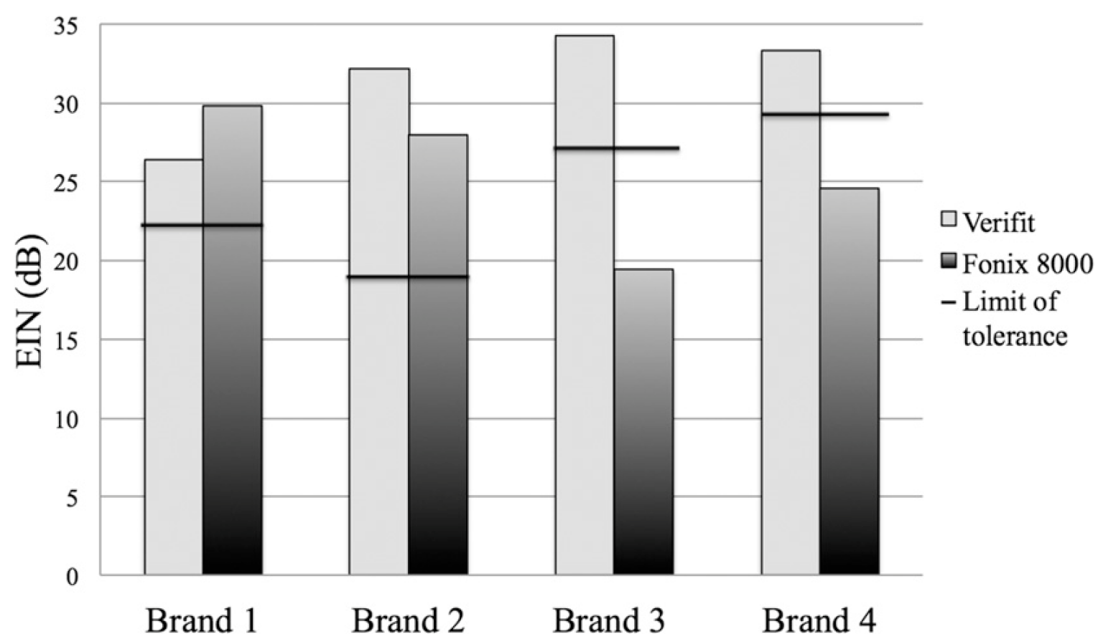
Internal Noise
Equivalent Input Noise (EIN)
Expansion activated
Holder, Picou, Gruenwald, Ricketts (2016).
J Am Acad Audiol, 27, 619-627.

Slide 10
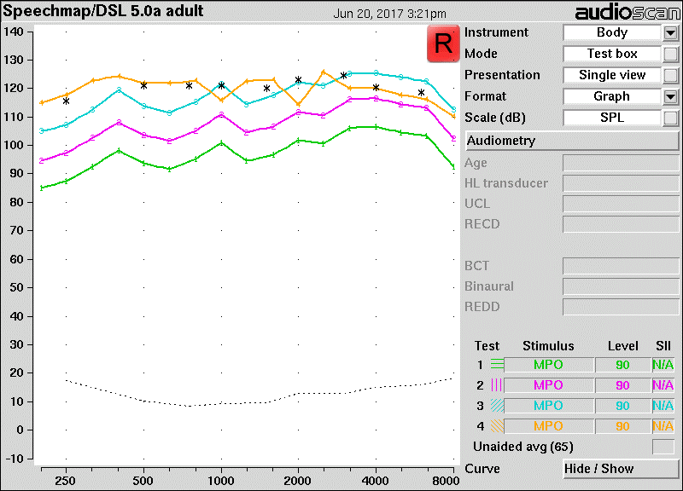
Maximum Output
90-dB SPL tones; flat 10-40 dB linear gain
Gain = 40 dB
Gain = 30 dB
Gain = 20 dB
Gain = 10 dB
Notes:
Changes in the frequency responses can be seen for the +20 dB volume setting, which is a strong indication that output levels were at saturation. The output levels are not much different from the levels for the +10 dB volume setting; therefore, it is possible that saturation levels were also reached for this latter setting at some frequencies.

Slide 11
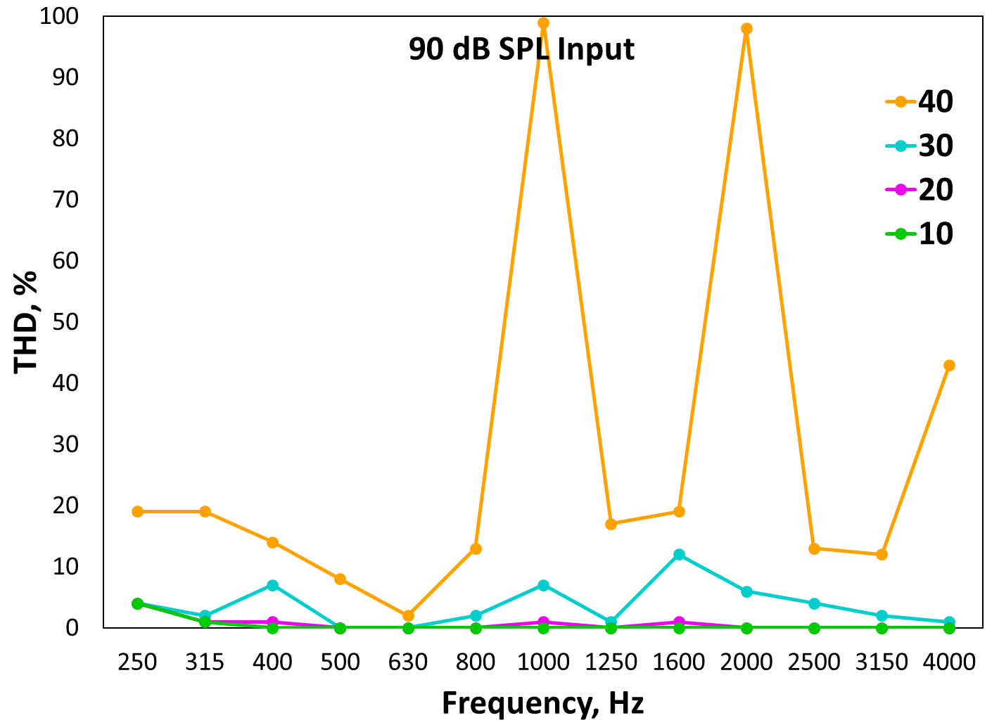
Distortion
Total Harmonic Distortion (THD)
Distortion only when output level is high
Indicates that the front-end components (microphone, ADC, etc.) are not in saturation with high input levels

Slide 12
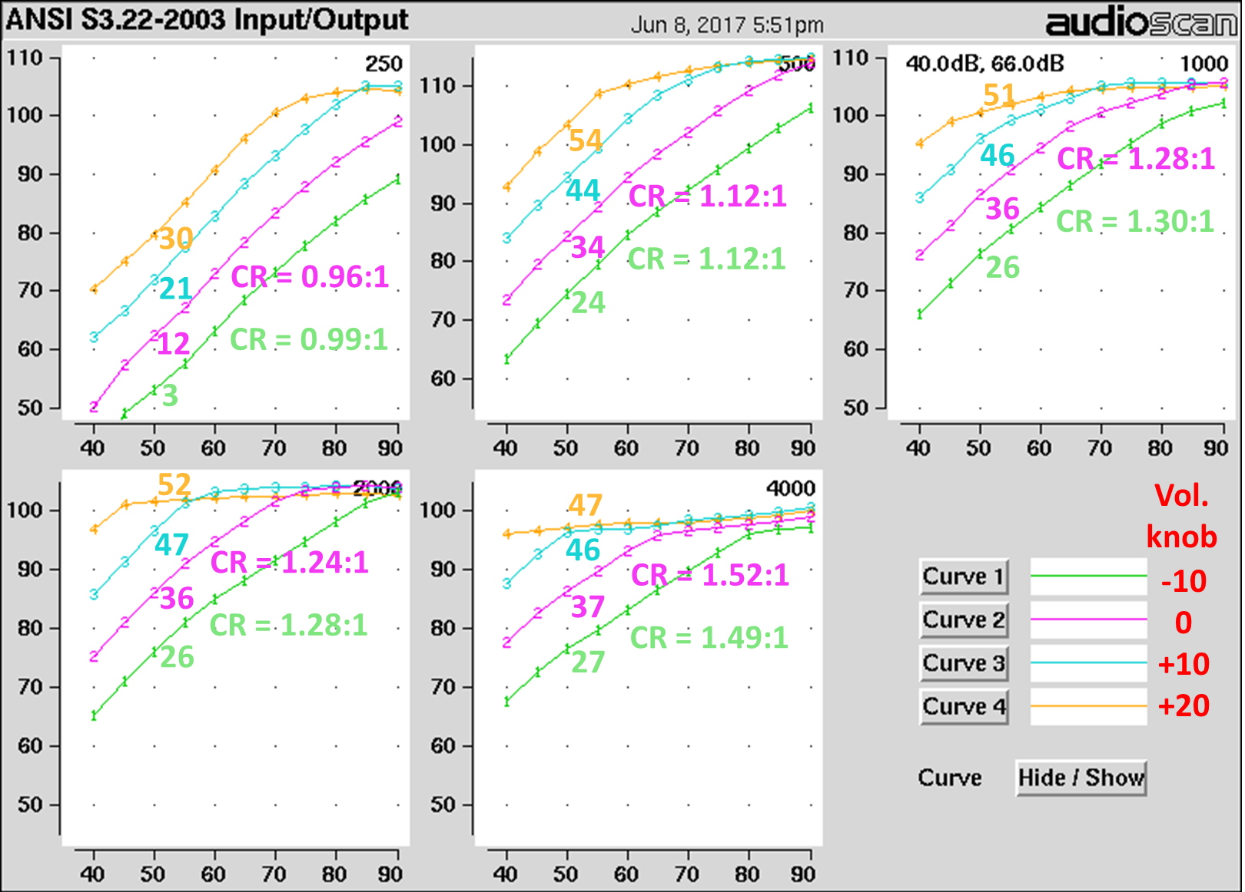
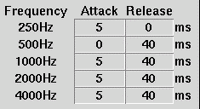
Compression Characteristics
WDRC CT = 50 dB SPL, CR = 1.5:1; OLC = 105 dB
115
106
105
104
101

Slide 13
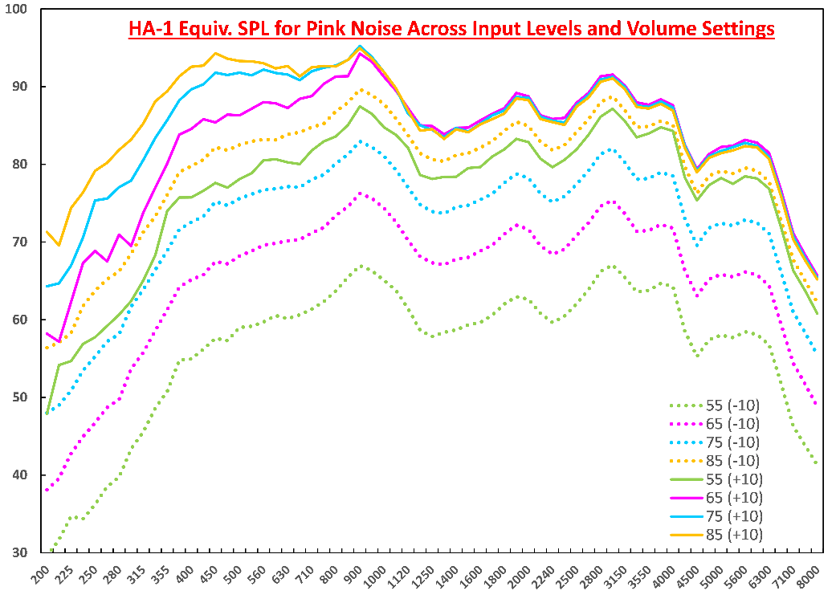
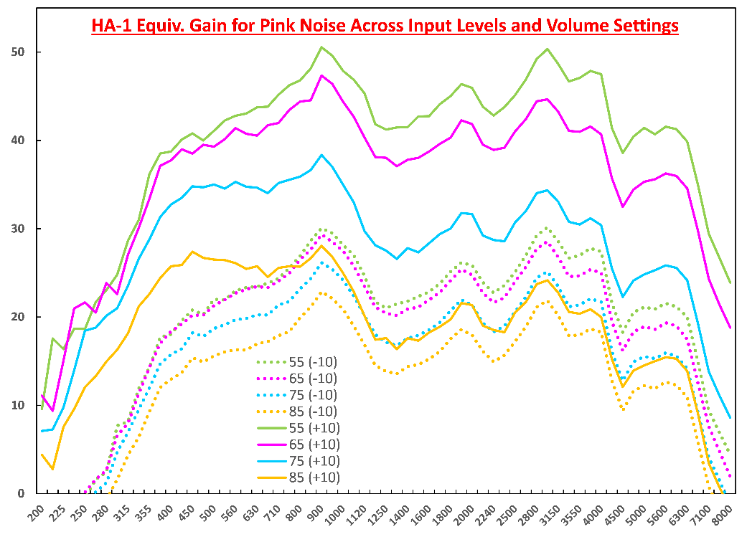
Frequency Response
BOLT
Relatively flat (300-4000 Hz), unvarying across changes in gain and input level
Output levels are effectively limited by OLC (BOLT)
Less effective for low frequencies → distortion (not shown)
Gain decreases with increasing input level (WDRC)
Distortion ‘free’ gain at least up to 40-50 dB
Notes:
To evaluate output levels and gain across frequency as function of input level
Relatively flat between at least 300-4000 Hz, excluding the various peaks, which I believe are associated with channel summation and/or acoustic resonances
The overall frequency response does not change much as input level is increased and that gain systematically decreases with increasing input level, which is expected since wide dynamic range compression was active
It is clearly noticeable that output is being limited as the input level is increased. This effect occurs for high frequencies before the low frequencies, thereby giving the overall frequency response a low-pass characteristic as the system is driven into saturation.
Likely that output limiting kept the high frequencies below the physical saturation limit of the earphones, but not for the low frequencies, resulting in an increase in low-frequency output levels accompanied by distortion.

Slide 14
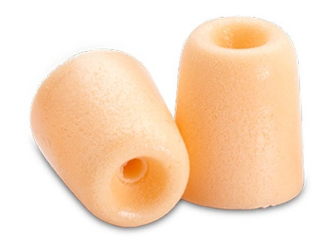
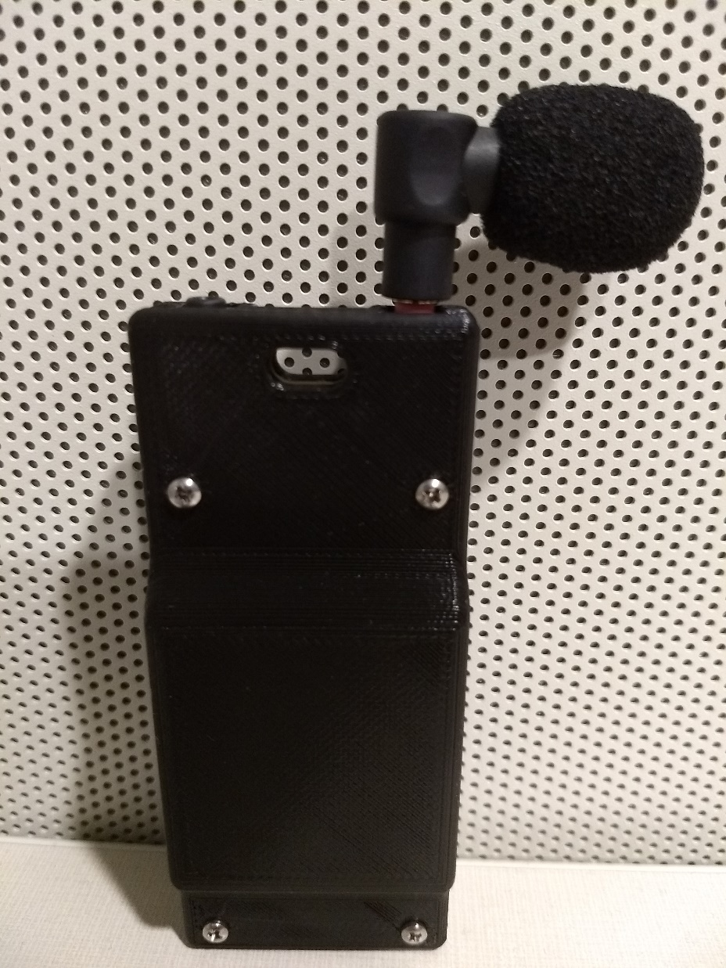
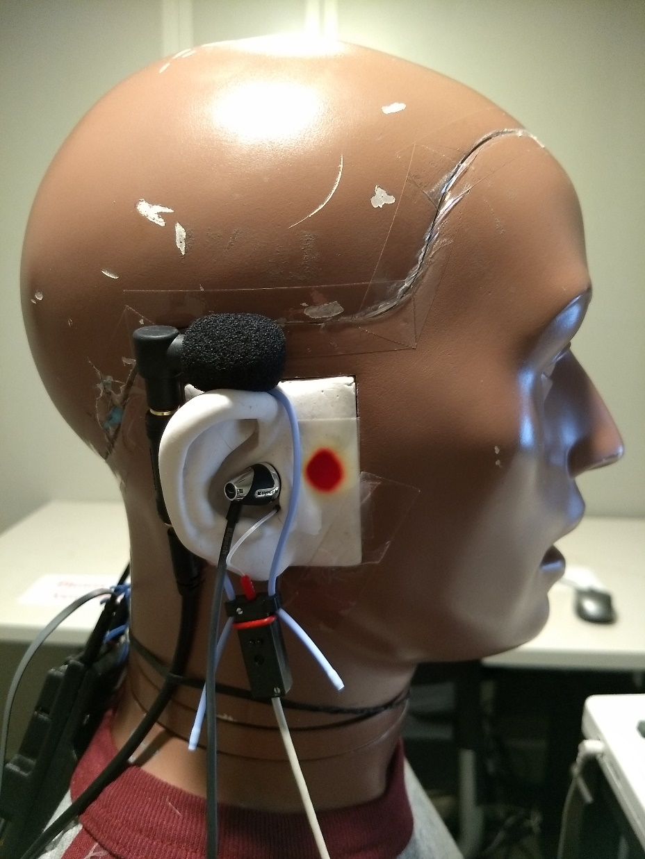
Directionality
Generic mini boom mic
~27 dB max gain before feedback

Slide 15
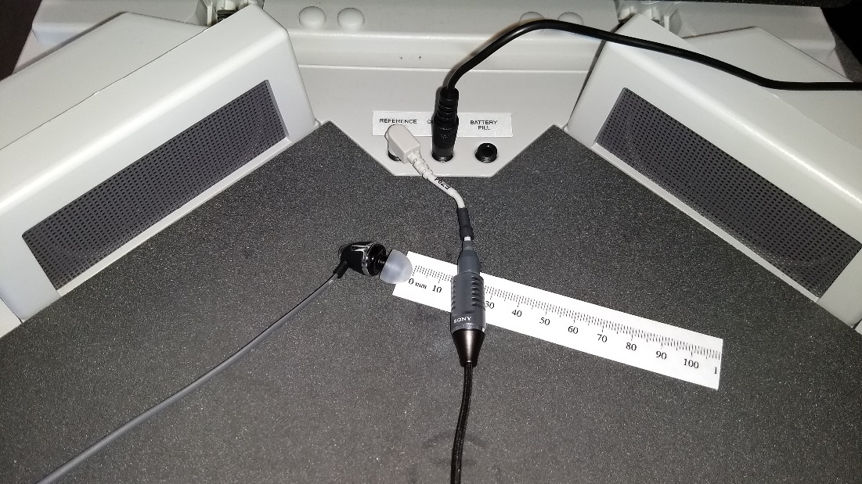
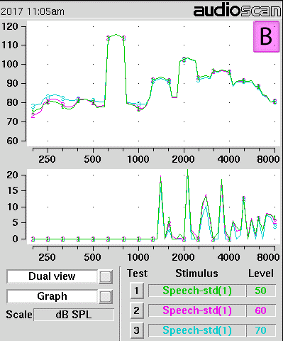
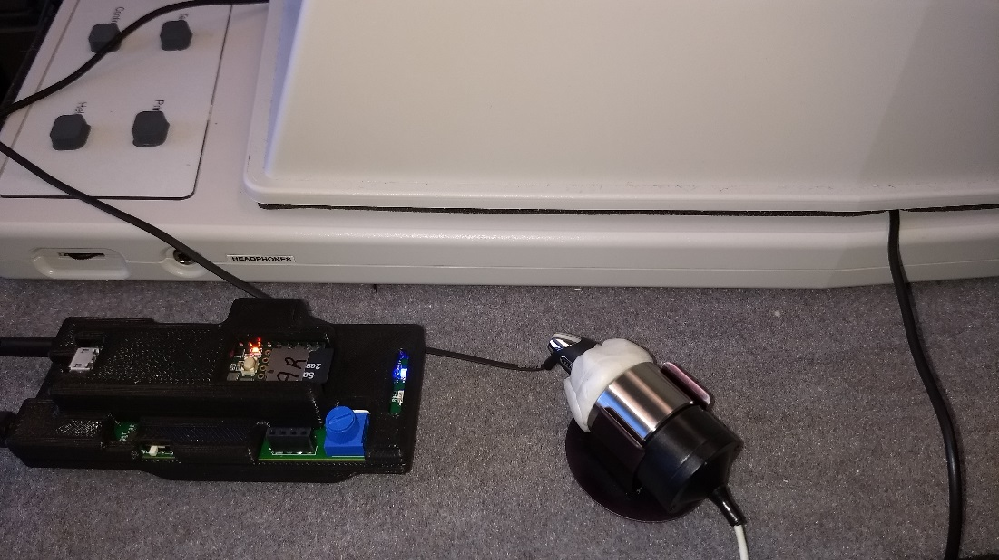
Feedback Testing

Slide 16
Directionality: KEMAR
Mounted on right ear; flat 20 dB linear gain
AI-DI = 9.1 dB
AI-DI = 8.2 dB
~15 dB Front-Back
Low distortion for 65 dB SPL input (0-2%)
Higher EIN (44 dB SPL) due to lack of expansion, equivalent to Sony omni mic (46 dB SPL)

Slide 17
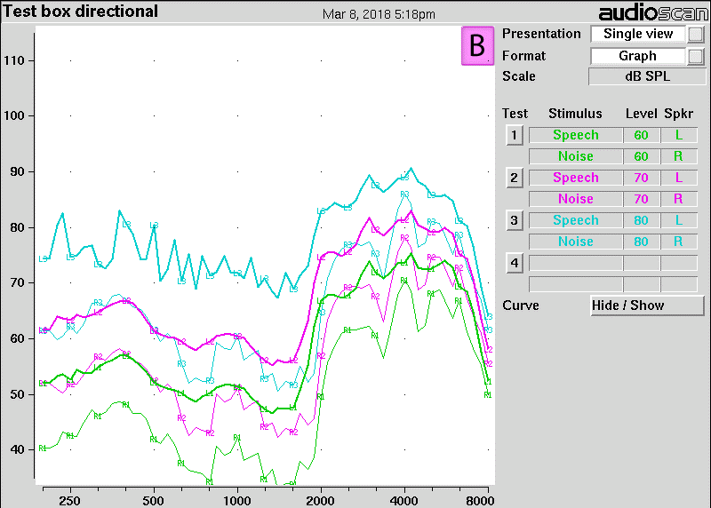
Directionality: Test Box
WDRC for a mild to moderate hearing loss
Input = 80 dB SPL
Input = 70 dB SPL
Input = 60 dB SPL

Slide 18
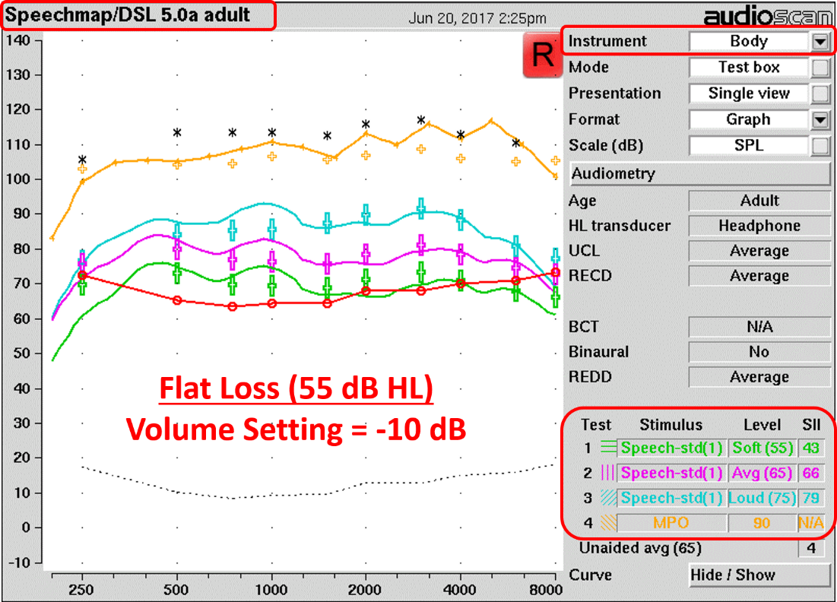
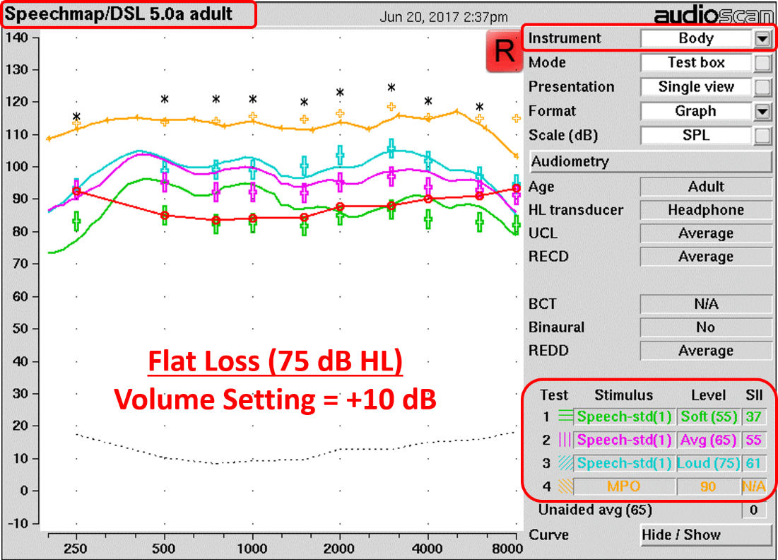
Audiometric Fitting Range
Hearing losses up to 70-75 dB HL can easily be accommodated
Can amplify soft speech with relatively modest internal noise and amplify high-level narrowband sounds with relatively low distortion for these losses
Notes:
An easy way to show this is to enter hypothetical hearing losses into the Verifit and it to compute and overlay the prescriptive target levels for each of the tests.
Solid red line corresponds to hearing thresholds converted into dB SPL at the tympanic membrane for an average adult ear

Slide 19
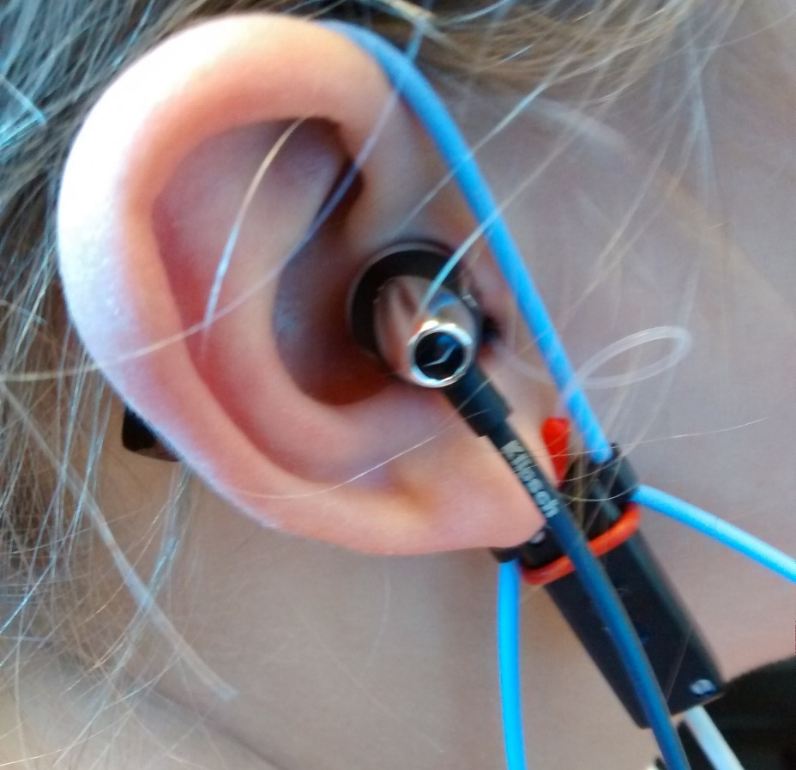
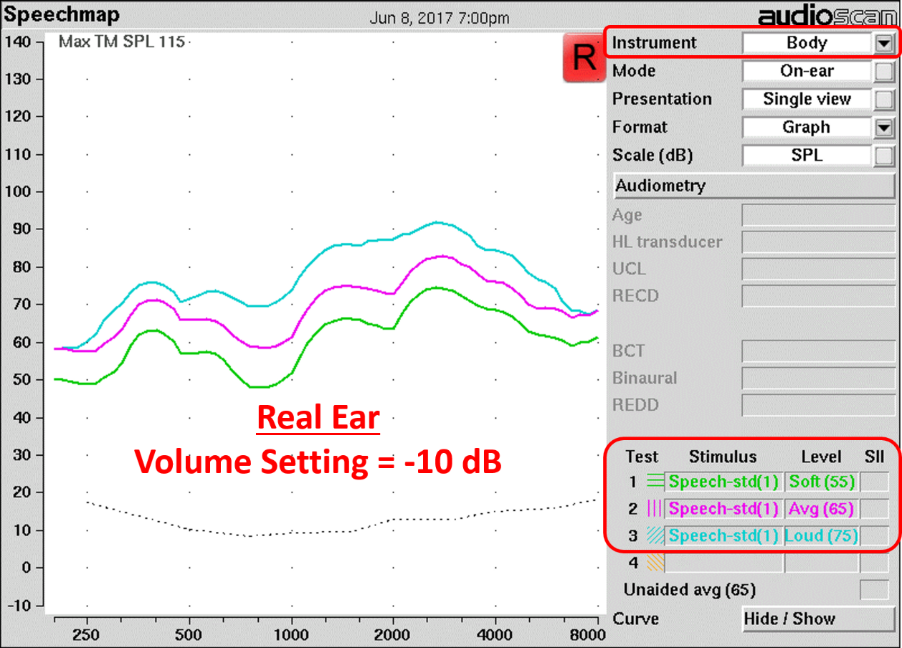
Probe Microphone Feasibility
Tympan can be tested like a regular hearing aid

Slide 20
Summary
Throughput delay: acceptable with basic WDRC
Internal noise: expansion needed to make acceptable
Maximum output: ~110 dB SPL w/ minimal distortion
Total harmonic distortion: 90 dB SPL input; 50 dB gain
Frequency response: smooth with gain/input changes
Compression parameters: WDRC parameters as advertised; OLC able to control max output
Directionality: basic using mini boom mic
Audiometric fitting range: ≤ 70-75 dB HL
Probe microphone feasibility: YES
Need feedback management!
Notes:
Electroacoustic evaluation of the Tympan unit programmed with 8-channel, wide dynamic range compression (WDRC) was conducted using a commercial hearing aid analyzer. In my expert opinion, the Tympan unit performed like an actual hearing aid: (1) throughput delay was measured to be 5.7 ms; (2) input/output curves clearly demonstrated the action of the WDRC, output limiting compression to control maximum output levels, and volume changes; (3) WDRC attack and release times equaled the nominal values in the software; (4) minimal distortion was evident at most volume settings; (5) internal noise levels were modest and comparable to today’s premium devices; (6) the frequency response was consistent across most input levels and was relatively flat with predictable peaks that probably could be smoothed away; (7) the microphone seemed to demonstrate adequate dynamic range, although the rising frequency response will need to be calibrated out before the signal is processed; (8) the amplifier was able to achieve at least 55 dB of gain with minimal distortion; (9) the Tympan unit with Klipsch earphones seems to be capable of accommodating hearing losses up to 70 and maybe 75 dB HL; and (10) real-ear measurements using a probe microphone were easily performed. Overall, based on my expert opinion, the Tympan unit at its current stage of development is ready to be made available to a wider group of individuals within the hearing research community.

Slide 21
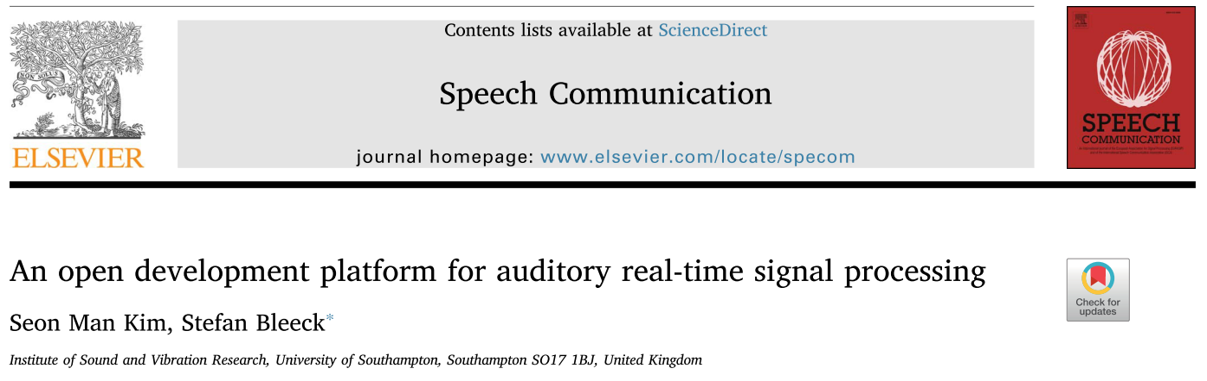
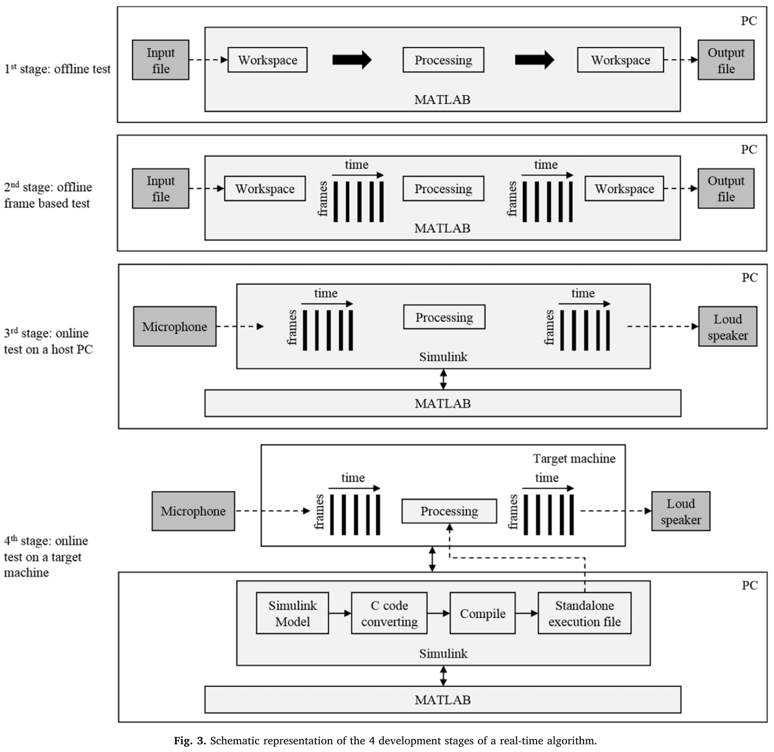
Kim & Bleeck (2018). Speech Comm., 98, 73-84.

Slide 22

Thank You!
TinyURL.com/PurdueEAR

